Slide 1


Slide 2
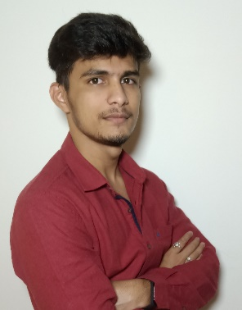


Project Highlights
Project Name : PyTool Configurator
Team Size : 05
BU Mentor Name : Mentor PS#
Deepak Kumar Sahoo
40013395
CVR College of Engineering(ECE)
Mula Reethu
40013397
GNITS
(ECE)
Samudrala Apurva
40013399
GNITS
(ECE)

Slide 3
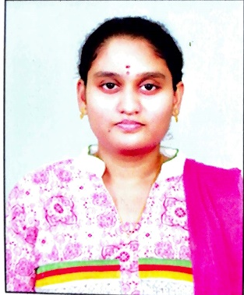

Project Highlights
Project Name : PyTool Configurator
Team Size : 05
BU Mentor Name : Mentor PS#
Neeli Usha Chinmai Sai
40013390
Sri Vasavi Engineering College, AP(CSE)
Chinnam Ashutosh Patro
40013396
NIST, Orissa(CSE)

Slide 4
Project Summary
In the project PyTool Configuration, we have tried to include basic operations using python script dealing with Virtual Machine.
Operations that are performed are like :
Development of Menu driven program which able to access the menu displayed
Creating the VM and Deleting the VM
Getting information from the VM

Slide 5
Future development that can be implemented further
Future developments :
Features like logging all the outputs in the guest machines to a file in our host machine
Other features can be added as per the requirements as it is flexible to add features further and can be updated for future development .

Slide 6

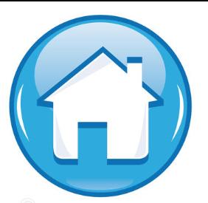
Thank You !

